Slide 1

Supermarket Sales Analysis
By Nathan Jude Furtado

Slide 2
Key Visualizations
Gross income by Customer type, Gender, Branch
01
Gross Income by City
02
Sales by time of day
03
Top 4 Products lines
04
Gender wise measures
05

Slide 3
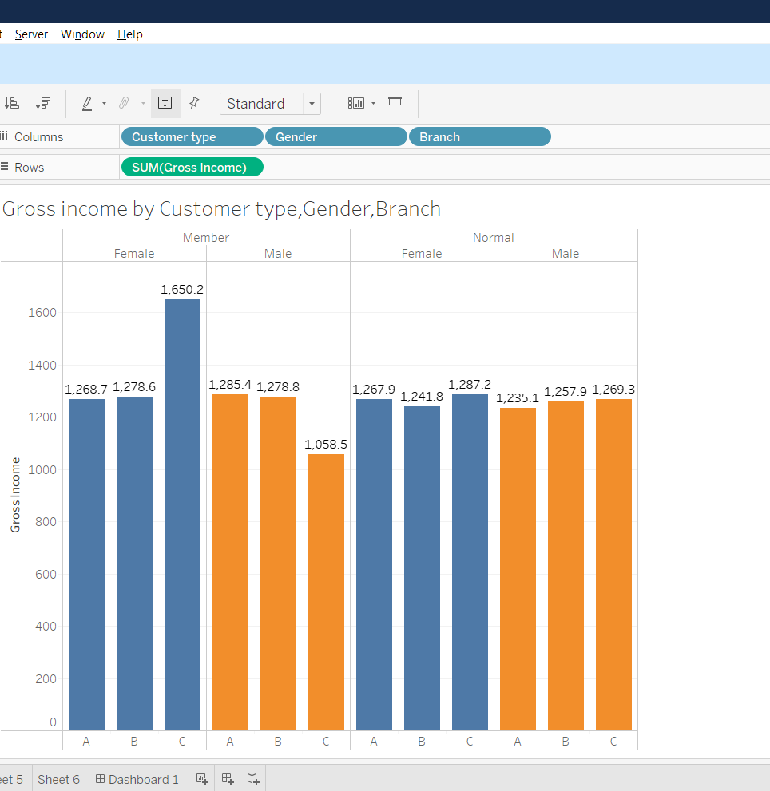
Gross income by Customer type, Gender, Branch
Members tend to generate slightly higher gross income compared to normal customers.
Possible reason: Members may purchase larger baskets or benefit from loyalty programs.
Insight: Focusing on Member retention and expanding membership programs could boost revenu

Slide 4
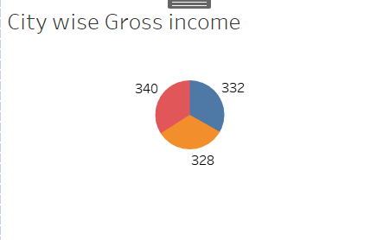
City wise Income
Yangon typically shows he highest total gross income, driven by a larger number of transactions and a broader customer base.
Mandalay contributes a moderate share of gross income, reflecting stable but slightly lower sales activity compared to Yangon.
Naypyitaw often has the lowest total gross income; however, when looking at average gross income per transaction, it may perform competitively — suggesting that while fewer customers shop there, they tend to make higher-value purchases.

Slide 5
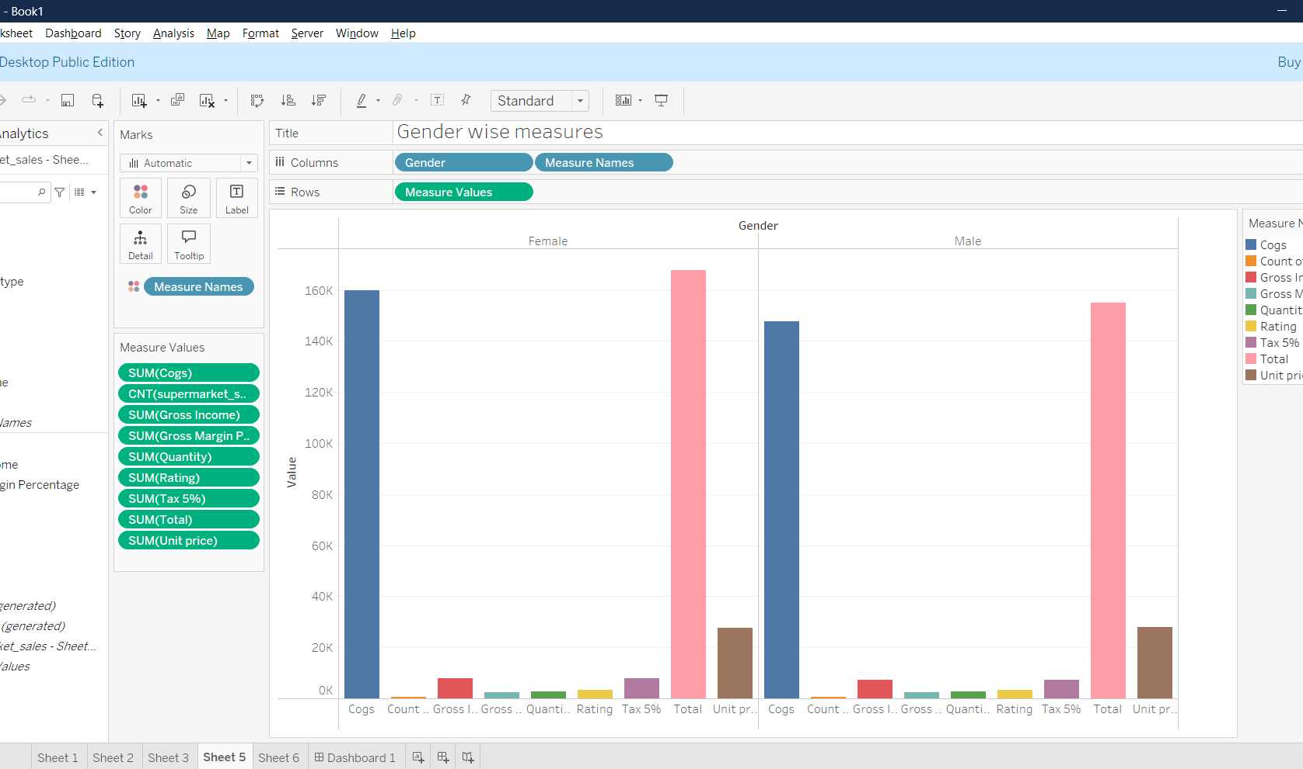
Gender-wise Measures
COGS is slightly higher for Females than for Males, indicating more product costs associated with female purchases.
Total Sales are higher for Female customers compared to Male customers.
Gross Income and Gross Margin % show a marginal difference between genders, with Females slightly leading.
Quantity purchased is fairly similar across genders, suggesting no significant difference in the number of items bought.
Ratings (customer satisfaction) are almost even for both genders.
Unit Price (average selling price per item) appears slightly higher for Males than for Females.
Tax (5%) collections mirror the Total Sales trend — higher among Female customers.

Slide 6
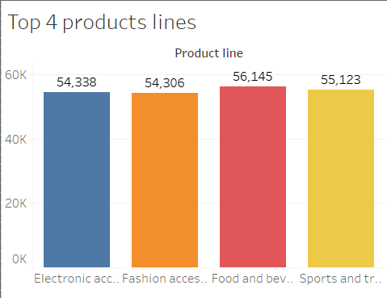
Gross income by Customer type, Gender, Branch
The top 4 categories are:
Food and Beverages – 56,145
Sports and Travel – 55,123
Electronic Accessories – 54,338
Fashion Accessories – 54,306
Key Insights:
Food and Beverages leads all categories, showing it is the most purchased product line.
All four product lines have very close total sales, indicating diverse customer interests across categories.
The narrow gap between them suggests balanced sales performance, with no single category dominating by a large margin.

Slide 7
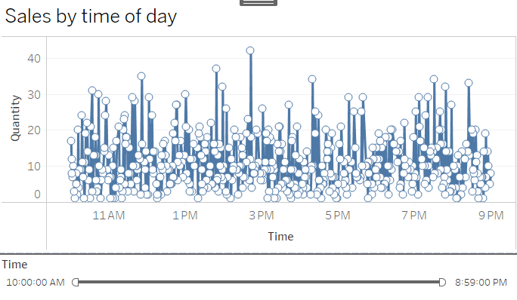
SALES BY TIME OF DAY
The line/scatter plot displaying sales by time of day. The x-axis represents the time of day, ranging from 10:00 AM to 9:00 PM, while the y-axis represents the quantity of sales. The data points (represented as circles) indicate the quantity sold at each specific time.
At the bottom of the image, there's a slider filter that allows users to adjust the time window displayed on the graph. By sliding the filter, users can zoom into specific hours of the day to analyze the sales for a particular time range more closely.

Slide 8
THANK YOU

